Slide 1
Bluemix platform as a service (PaaS)
IBM Cloud Ecosystem Development team

Slide 2
Objective
After completing this module you will be able to:
  Describe key components of IBM Bluemix PaaS application framework
  Describe key infrastructure components of IBM Bluemix PaaS and Cloud Foundry
  Explain the process of staging an application in IBM Bluemix PaaS
  Describe the organization management elements in IBM Bluemix PaaS: Spaces, Users, Domains and Quota
  Understand IBM Bluemix Regions and how to manage applications in multiple regions
  Use the Cloud Foundry CLI (cf) tool to manage applications in IBM Bluemix PaaS
Notes:
TOR note – this set objective is for all of section 2. Suggest highlighting first bullet (2.1), or omit this slide

Slide 3
Bluemix Applications
Use cases categories
Web Applications
Mobile Back Ends
Enabling online experiences in the physical store for retail
Back end services replacing custom code hosted on IaaS (e.g. Push Notification)
Leverages BlueMix for data collection APIs and dashboards
Cloud Code for offloading business logic from the mobile client
Reduction of infrastructure setup from days to minutes by moving off of a pure IaaS
Integrated into iOS and Android native applications using BlueMix SDK
APIs and On-Prem Integration
Analytics and Reporting
Providing APIs that are integrated into the BlueMix experience
Embed IBM Cognos business intelligence content into apps
Leveraging existing on premise databases and technologies
Use IBM Analytics Warehouse to store and analyze business data
Building mobile applications that connect to on-prem data via Bluemix
Gain immediate visibility and control over app performance and availability
Notes:
In Bluemix, an application, or app, represents the artifact that a developer is building. The application lifecycle in Bluemix and Cloud Foundry are identical, regardless of how you push the application to the Bluemix.
We’ve seen apps created in Bluemix and have derived four key categories of use cases from that data. Web Application and Mobile Back ends are two most common categories that Bluemix applications fall into. Mobile Apps: Mobile apps run outside of the Bluemix environment and use services that the mobile apps are exposed to. Web Apps: Web apps consist of all the code that is required to be run or referenced at run time.
*Reference key categories and a selection of bullets mentioned on the slide

Slide 4

Key components of IBM Bluemix PaaS application framework
IBM Bluemix
Notes:
Before create an application in Bluemix, it’s important to understand Bluemix concepts and features.

Slide 5
Terminology
Starter - A starter is a template that includes predefined services and application code that is configured with a particular buildpack. There are two types of starters: boilerplates and runtimes.
Boilerplate - A boilerplate is a container for an application and its associated runtime environment and predefined services for a particular domain.
Runtime - A runtime is the set of resources that is used to run an application. Bluemix provides runtime environments as containers for different types of applications. The runtime environments are integrated as buildpacks into Bluemix, are automatically configured for use, and require little to no maintenance.
Buildpack - A buildpack is a collection of scripts that prepare your code for execution on the target PaaS. A buildpack gathers the runtime and framework dependencies of an application. Then, it packages them with the application into a droplet that can be deployed to the cloud.
Service - A service is a cloud extension that is hosted by Bluemix. The service provides functionality that is ready-for-use by the app's running code. The predefined services that are provided by Bluemix include database, messaging, push notifications for mobile apps, and elastic caching for web apps.
Notes:
A list of common Bluemix components will be used when you start building your applications in Bluemix environment. This slide shows the definition of Bluemix Starter, Boilerplate, Runtime, Buildpack and Service. Bluemix is designed for self-service oriented support. Each of these components in the list provide documentation with instructions to help you get started. You can choose from a package of sample code and services such as Bolierplate or start from scratch with Runtime (the set of resources used to run the application) or Runtime environment (an integrated set of resources that are used to run a program or process) to build your applications. Bluemix also allows your to bring your own Buildpacks ( a collection of scripts that prepare your code to run on Bluemix) for your application.
We will discuss the components in detail later.

Slide 6
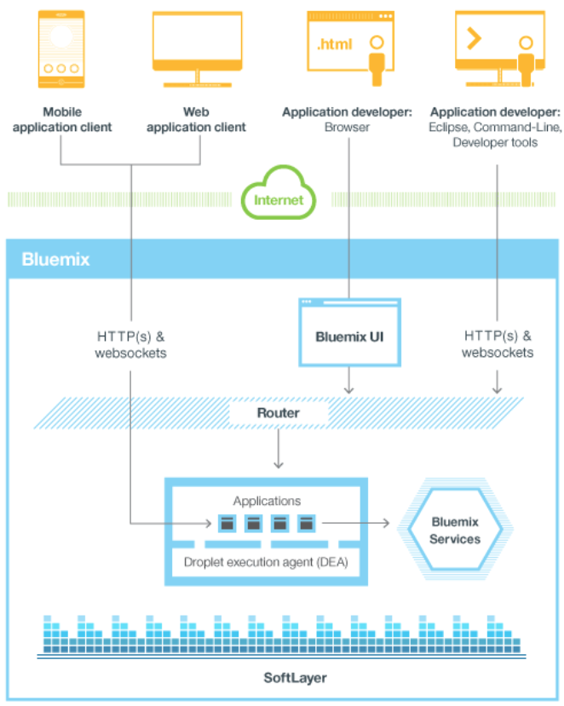
High Level Bluemix Public PaaS Architecture
Notes:
Bluemix is an environment for you to develop apps and use services that provide ready-to-use functions. Bluemix also provides an environment to host application artifacts that run on an application server such as Liberty. By using SoftLayer, Bluemix deploys virtual containers that host each deployed app. In this environment, the app can use pre-built services (including third-party services) to make app assembly easy.
As a developer, you can interact with the Bluemix infrastructure by using a browser-based user interface. You can also use a Cloud Foundry command line interface, called cf, to deploy web apps.
Clients—which can be mobile apps, apps that run externally, apps that are built on Bluemix, or developers that are using browsers—interact with the Bluemix-hosted apps. Clients use REST or HTTP APIs to route requests through Bluemix to one of the app instances or the composite services.
This is Bluemix Public PaaS architecture. IBM also offers Dedicated Bluemix environment which replicates public Bluemix architecture with additional customizations for enterprise customers or MSPs.

Slide 7

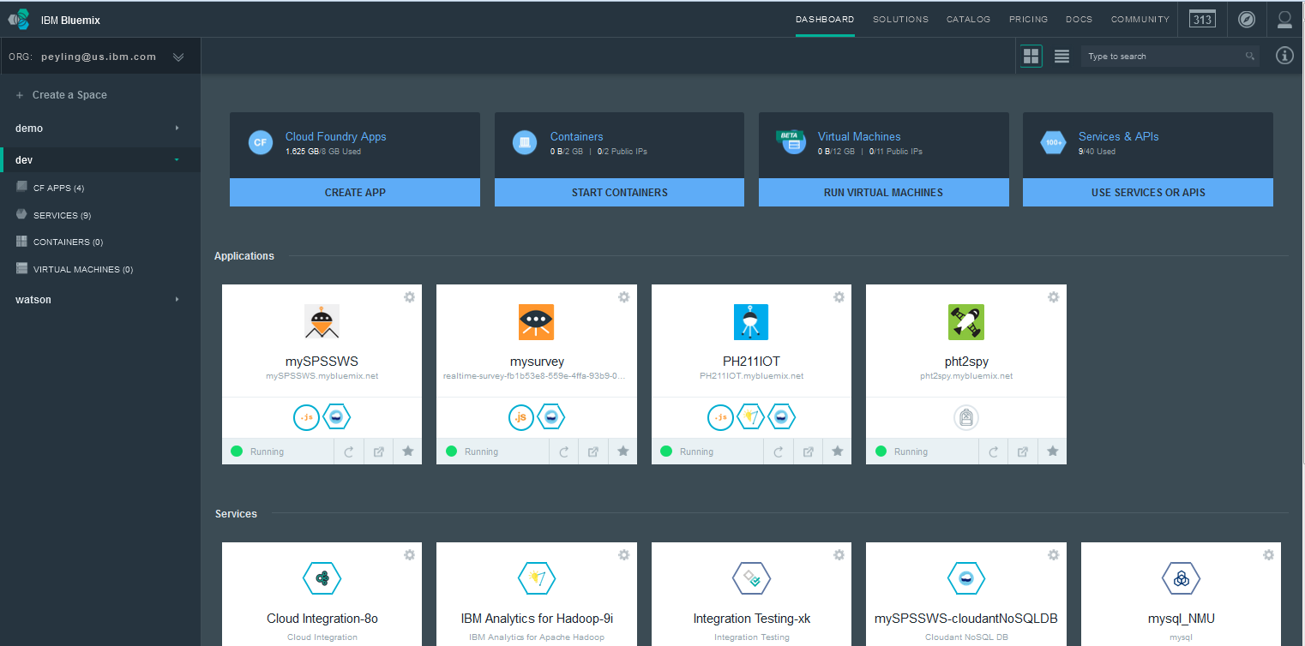
Bluemix Console Dashboard UI
Menu
Quick Stat and Notify
Organization
Spaces
Trial
Account
Usage
Status
App
Status
Dashboard Menu
Service
Instances
Deployed
Apps
Notes:
Bluemix users/developers can manage their accounts and applications from Bluemix console dashboard UI by using web browsers.

Slide 8
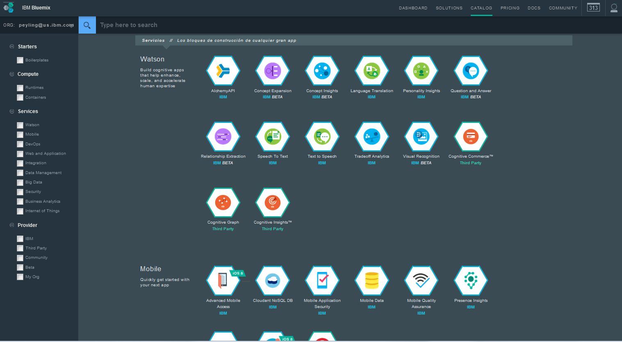
Catalog
Search
Filter
Notes:
Bluemix provides a list services that can be used by applications without requiring you to manage the setup and operation of those services
Available services are organized and listed in Catalog, including production-ready, Beta and experimental services.
The services in catalog are from IBM, 3rd party and community. Users can filter and search the services and view the brief description for each of service offering.

Slide 9
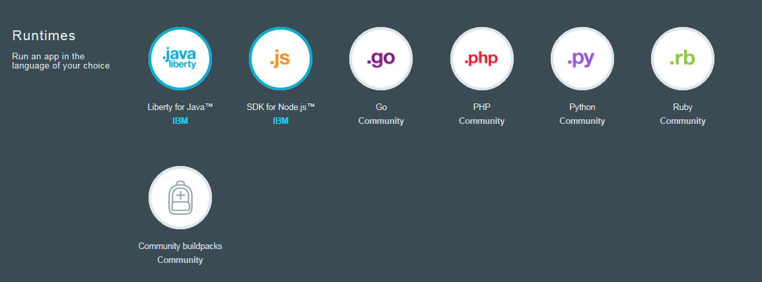
Starters - Runtimes
Starters – A template that includes predefined services and application code. Two type of starter- Boilerplates and Runtimes
Runtimes
  Deploying a runtime will deploy a starter ‘hello world’ application
    Quick start with starter application code provided
  Buildpacks provide the runtime for an application running on Bluemix.
    Built-in IBM buildpacks
    Built-in community buildpacks – Provided by Cloud Foundry Community
    External buildpacks( a.k.a. Bring your own buildpacks )– Cloud Foundry CLI deployment only, cannot deploy from web UI
Notes:
In Bluemix, A starter is a template that includes predefined services and application code that is configured with a particular buildpack. There are two types of starters: boilerplates and runtimes.
A runtime is the set of resources that is used to run an application. Bluemix provides runtime environments as containers for different types of applications. The runtime environments are integrated as buildpacks into Bluemix, are automatically configured for use, and require little to no maintenance.
A buildpack is a collection of scripts that prepare your code for execution on the target PaaS. A buildpack gathers the runtime and framework dependencies of an application. Then, it packages them with the application into a droplet that can be deployed to the cloud.

Slide 10
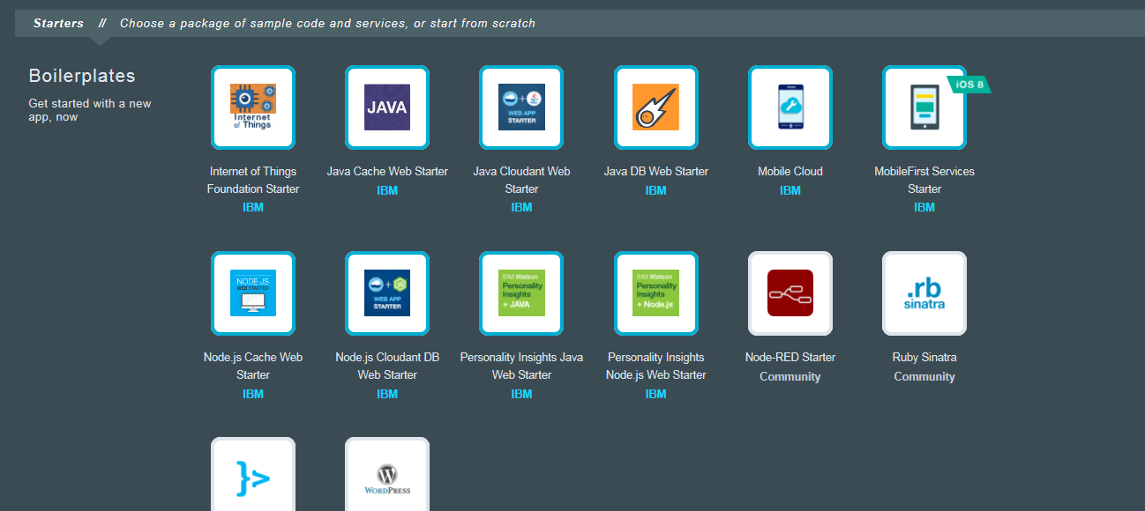
Starters - Boilerplates
Boilerplates
  Deploys a Runtime, service(s) and sample code
    Quick start with access to sample application code
Notes:
A boilerplate is a container for an application and its associated runtime environment and predefined services for a particular domain. You can use a boilerplate to quickly get up and running. For example, you can select the Mobile Cloud boilerplate to host mobile and web applications and accelerate development time of server-side scripts by using the mobile app template and SDK.

Slide 11














Bluemix Services
A service is a cloud extension that is hosted by Bluemix.
The building blocks of applications
The service provides functionality that is ready-for-use by the app's running code.
  Predefined services available from IBM, 3rd party and community on Bluemix
  Bluemix provisions new service instances and binds services to applications
Two types of services:
  Managed Service: A Managed Service integrates with Bluemix/Cloud Foundry via a service broker that implements the Service Broker API. Service broker advertises a catalog of service offerings and service plans to Bluemix/Cloud Foundry, and receive calls from Cloud Foundry for four functions: create, delete, bind, and unbind. The broker then passes these calls onto the service itself.
  User Provided Service: Managed Services have been integrated with Bluemix/Cloud Foundry via APIs and enable end-users to provision new service instances and credentials on demand. User-provided Service Instances are a mechanism to deliver credentials to applications for service instances which have been pre-provisioned outside of Bluemix/Cloud Foundry.
Notes:
A service is a cloud extension that is hosted by Bluemix. The service provides functionality that is ready-for-use by the app's running code. The predefined services that are provided by Bluemix include database, messaging, push notifications for mobile apps, and elastic caching for web apps.
You can create your own services in Bluemix. These services can vary in complexity. They can be simple utilities, such as the functions you might see in a runtime library. Alternatively, they can be complex business logic that you might see in a business process modeling service or a database.
Bluemix simplifies the use of services by provisioning new instances of the service, and binding those service instances to your application. The management of the service is handled automatically by Bluemix. For all available services in Bluemix, see the catalog in the Bluemix user interface.

Slide 12
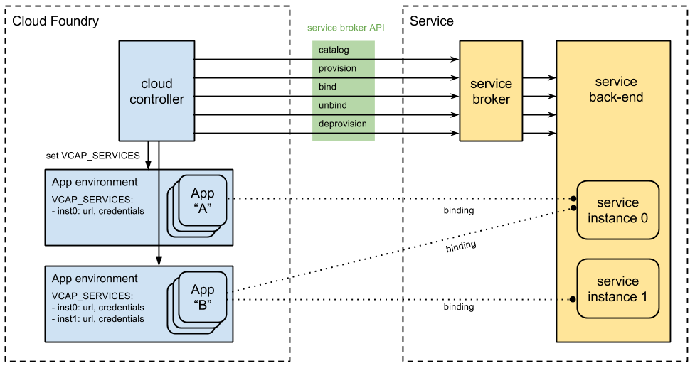
How Bluemix Service Instances Work
Notes:
BlueMix Services - In Bluemix/Cloud Foundry there are two types of services – User provided service instances and Managed service instances.
Managed Services have been integrated with Bluemix/Cloud Foundry via APIs and enable end-users to provision new service instances and credentials on demand. User-provided Service Instances are a mechanism to deliver credentials to applications for service instances which have been pre-provisioned outside of Bluemix/Cloud Foundry. A Managed Service integrates with Bluemix/Cloud Foundry via a service broker that implements the Service Broker API. Service broker advertises a catalog of service offerings and service plans to Cloud controller, and receive calls from Cloud controller for four functions: create, delete, bind, and unbind. The broker then passes these calls onto the service itself. Cloud controller sets the VCAP_SERVICES environment variable when binding your application to a service.

